Slide 1
Final Project-DSCI 6007-01-Team02
Student Name:
1. Sunaina Makkena
2. Anand Gopi Sai Krishna Polisetty
3. Gajendra Varma Penmetsa
Project Title:-
Time Series Forecaster: Advanced Stock Market Analysis & Prediction Tool
Date:30th April 2025
Notes:
For Educators: You can use this template to help your students effectively present and communicate their project to a broader audience. Your students can also use this presentation as a portfolio of their work to demonstrate their cloud skills.
The presentation structure is listed below. The total time may vary depending on the activity you want to conduct. For example, you may want your students to provide high-level walkthrough of their final solutions versus deep-dive into why or how they chose certain services and the steps of building their architectures.
Suggested timing for a 15-minute presentation:
Introduction – 30 seconds
Business scenario overview – 1 minute
Solution overview – 5 minutes
Architecture diagram of the solution – 2 minutes
Demo – 5 minutes
Lessons learned – 1.5 minutes

Slide 2



TEAM
Sunaina - Data Analyst
Anand – Data Engineer
Varma – Data Scientist

Slide 3
Introduction:-
Time series data—sequential observations collected over time—is fundamental to decision-making across finance, retail, manufacturing, and numerous other fields. The Advanced Time Series Analyzer transforms complex forecasting techniques into an accessible tool for professionals without requiring statistical or programming expertise.
This application addresses key challenges in time series analysis by automatically identifying patterns (trends, seasonality, cycles), applying appropriate models (ARIMA, SARIMA, LSTM), and evaluating prediction accuracy through clear visualizations and metrics. Users can upload historical data, configure model parameters through an intuitive interface, and generate reliable forecasts to support strategic planning and operational decisions.
Whether analyzing stock market trends, predicting sales volumes, or forecasting resource requirements, this tool provides the analytical capabilities needed to transform historical patterns into valuable future insights.

Slide 4
Business scenario overview
Problem or opportunity statement:
Most sectors rely on time series data for critical decision-making (e.g., stock prices, climate, demand trends).
Non-technical teams often struggle with existing tools like Excel or custom-coded solutions.
Advanced forecasting methods are typically inaccessible to those without data science expertise.
There's a clear opportunity to deliver a simple, intelligent, and user-friendly interface for effective time series forecasting.
Notes:
Define the problem or opportunity that you are addressing. Include pictures, figures, and statistics to help the audience better conceptualize the problem or opportunity.
Specify who your users or customers are and what pain points they are experiencing.
For example: “Users complain that the student admissions department website is too slow and isn’t always available.”
Also, list any specific business requirements that you are addressing.
For example: “Improve the experience for users. The web application can be deployed to the AWS Cloud. The application must be highly available, scalable, load balanced, secure, and performant architecture that can support thousands of users.“
Note:
An above-bar overview succinctly defines the problem and opportunity statement. For example: “Customers with media files, such as retail companies, need an easy and cost-effective way to analyze photos and videos of their inventory.”
A below-bar overview is too verbose, technical, or not specific. For example: “The most common media files are .jpg and .mp4. Companies have media files of their inventory.”

Slide 5
Solution Requirements:
Provide an easy-to-use, code-free user interface for time series data uploading and analysis.
Support multiple forecasting models (e.g., ARIMA, SARIMA, LSTM neural networks).
Preprocess data automatically (e.g., parsing of datetime, replacing missing values, detection of seasonality).
Offer visual insights: time series plots, decompositions, and accuracy statistics on forecasts.
Offer scalability with cloud deployment options (e.g., AWS EC2, S3, Lambda).
Offer secure file handling with temporary storage and validation controls.

Slide 6
Solution overview:
High-level description:
Intuitive Streamlit-based interface - Step-by-step flow: Upload → Model Select → Forecast → Interpret Results.
Adaptable to multiple time frequencies - Works with daily, weekly, monthly, or unevenly spaced time series data.
Optimized for small to medium datasets - Fast runtime and low memory usage suitable for personal and business forecasting tasks.
Code-free web-based time series forecasting tool.
Supports CSV upload for easy inputting of data.
Includes classical (ARIMA, SARIMA) and deep learning (LSTM) models.
Automates data preprocessing, forecasting, and result visualization.
Notes:
Explain at a high level what you have built.
For example: “I built a web application for a company to host their blog.“
Talk about why you chose certain parts of the solutions and any tradeoffs that you made. Focus on how you designed the solutions and how you applied the AWS Well-Architected Framework as part of the process (AWS Well-Architected Framework: https://docs.aws.amazon.com/wellarchitected/latest/framework/welcome.html).
For example: “I configured load balancers and auto scaling to make the application highly available and reliable.”
Include the use cases that you are addressing. Think about who your users are and how they would want to interact with your solution to solve their problem.
For example: “Users can view, upload, edit, and delete blog posts. Administrators can approve blog posts.”
Talk about the use cases that you addressed as part of the minimum viable product (MVP) that you scoped and built.
Note:
An above-bar description is concise and includes the most important benefits. For example: “The solution allows customers to quickly upload, store, and search large catalogs of images and videos in Amazon S3.”
A below-bar description is too detailed or not specific. For example: “Our solution analyzes media files.”

Slide 7
Solution overview:
Design considerations:
User Experience: Adjustable interface for upload, config, and results.
Model Flexibility: Blend of statistical and deep learning models.
Scalability: Cloud-deployable (AWS EC2, S3, Lambda, SageMaker).
Data Handling: Auto-parsing of dates, missing value handling.
Security: In-transit storage and upload validation.
Extensibility: Modular codebase allows easy integration of future models, APIs, or real-time data sources.
Performance Optimization: Designed to run efficiently on low-resource environments with optimized forecasting pipelines and minimal latency.

Slide 8
Solution overview
Use cases:
📈 Stock Market Forecasting: Predict stock trends using historical pricing data.
🌦️ Weather Prediction: Forecast temperature or rainfall using seasonal models.
🏭 Industrial Equipment Monitoring: Predict machinery wear or resource usage.
🧪 Healthcare Resource Planning: Estimate resource needs (beds, vaccines).
🛒 Retail Sales & Demand Forecasting: Anticipate sales spikes for inventory.
🎓 Educational Resource Planning: Predict student enrollments or course demand to allocate classrooms and instructors.
📱 App Usage or Website Traffic Forecasting: Use historical user activity to anticipate spikes or drops in engagement.

Slide 9
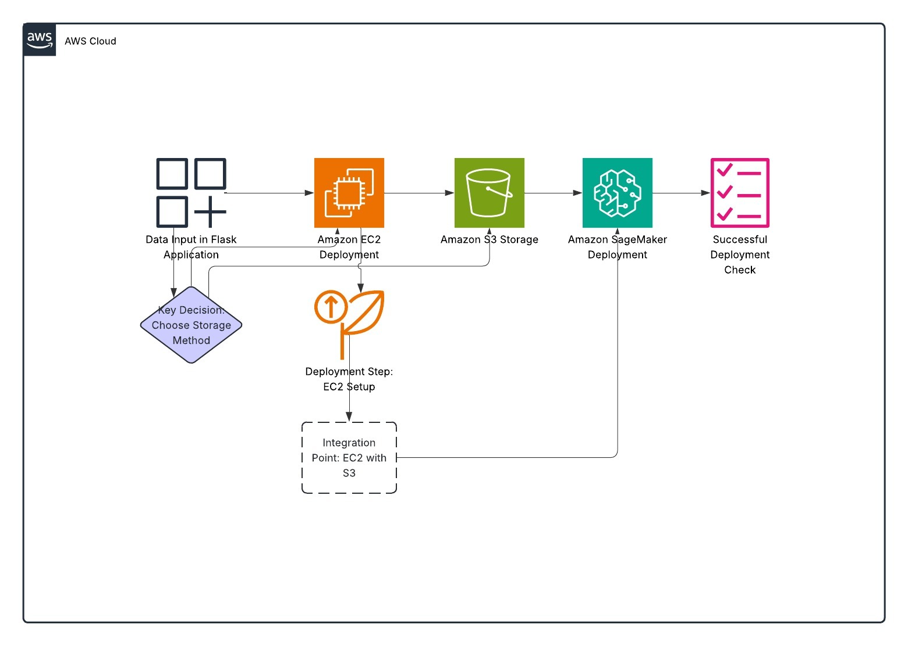
Architecture Diagram of the Solution:

Slide 10
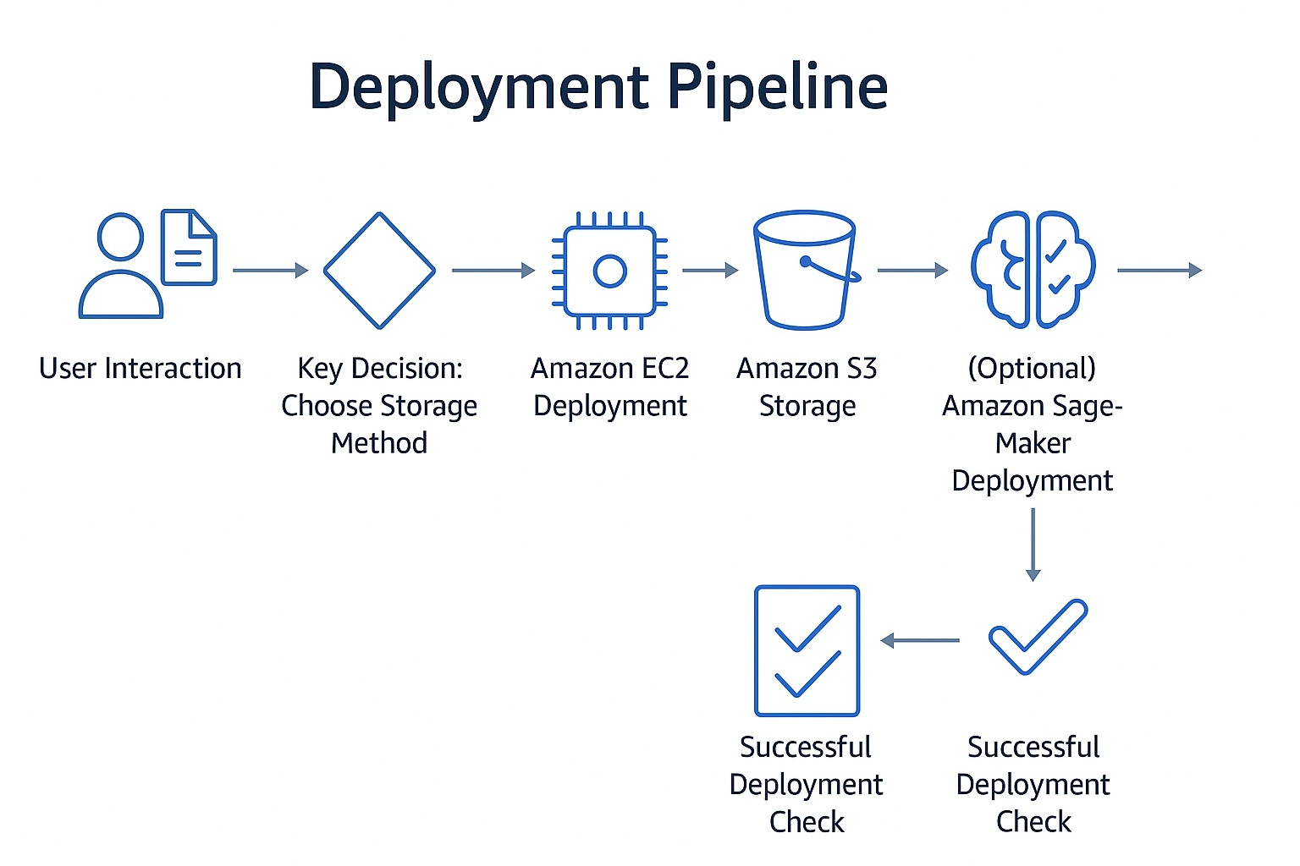
Data Pipeline:-

Slide 11
Lessons learned
Challenges overcame:
Model Integration-Integrating the LSTM model into the Streamlit web application successfully, with runtime performance considerations and correct prediction accuracy.
Data Diversity Handling-Dealing with different time series types (daily, monthly, irregular intervals) and making the app dynamically accept different input structures.
Scalable Deployment-Developing and deploying an AWS-based infrastructure with a good balance between performance, low latency, and cloud-native scalability.
Resources:
Statsmodels & pmdarima-Primary libraries used to develop and tune ARIMA/SARIMA forecasting models.
PyTorch-Needed to develop, train, and run LSTM neural network models.
Streamlit Documentation-Enabled rapid development of an interactive and simple-to-use web UI for end users.
Notes:
Describe any challenges that you encountered and how you overcame those challenges.
For example: “I got stuck when I was creating an EC2 instance to host the application. I used the resources that were listed in the instructions to walk myself through the process to create a new EC2, and I was able to complete the task. The links to labs in other courses were very helpful.”
Describe any new skills that you learned from this project.
For example: “I learned how to set up auto scaling correctly so my resources were automatically adjusted and allocated at the lowest possible cost.”
Discuss any future, out-of-scope use cases in the next steps.
For example: “I would like to scale out the web application so that multiple departments can use it.”

Slide 12
Lessons learned
New skills:
LSTM Model Development-Developed and stacked deep learning models for time series forecasting using PyTorch.
Interactive Web App Creation-Built an interactive, dynamic interface using Streamlit.
AWS-Based Deployment-Gained hands-on experience in deploying an end-to-end forecast app using AWS services like EC2, S3, and Lambda.
Next steps:
Implement Hyperparameter Tuning-Add grid search or cross-validation to auto-optimize model performance.
Enable Real-Time Data Feeds-Integrate APIs or IoT streams for live forecasting and updates.
Containerize & Deploy with AWS ECS or Lambda-Package the app with Docker and deploy more effectively using AWS ECS or serverless architecture.

Slide 13
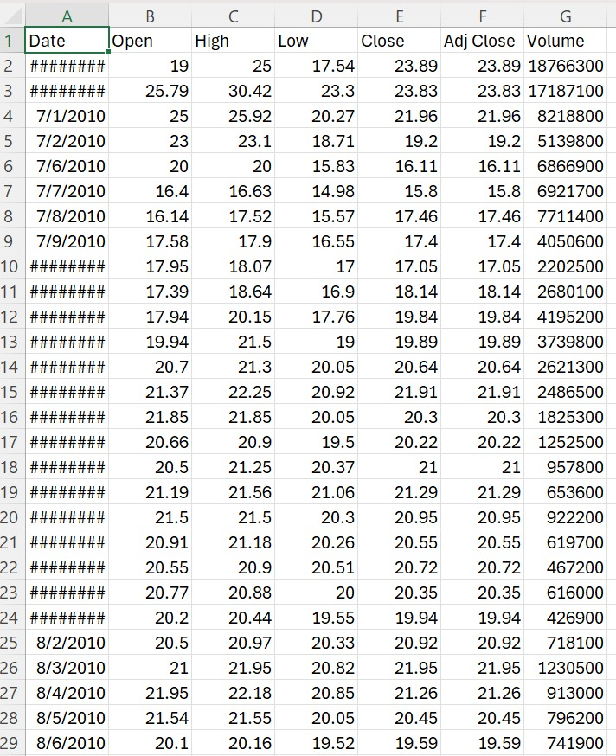
Data set sample:

Slide 14
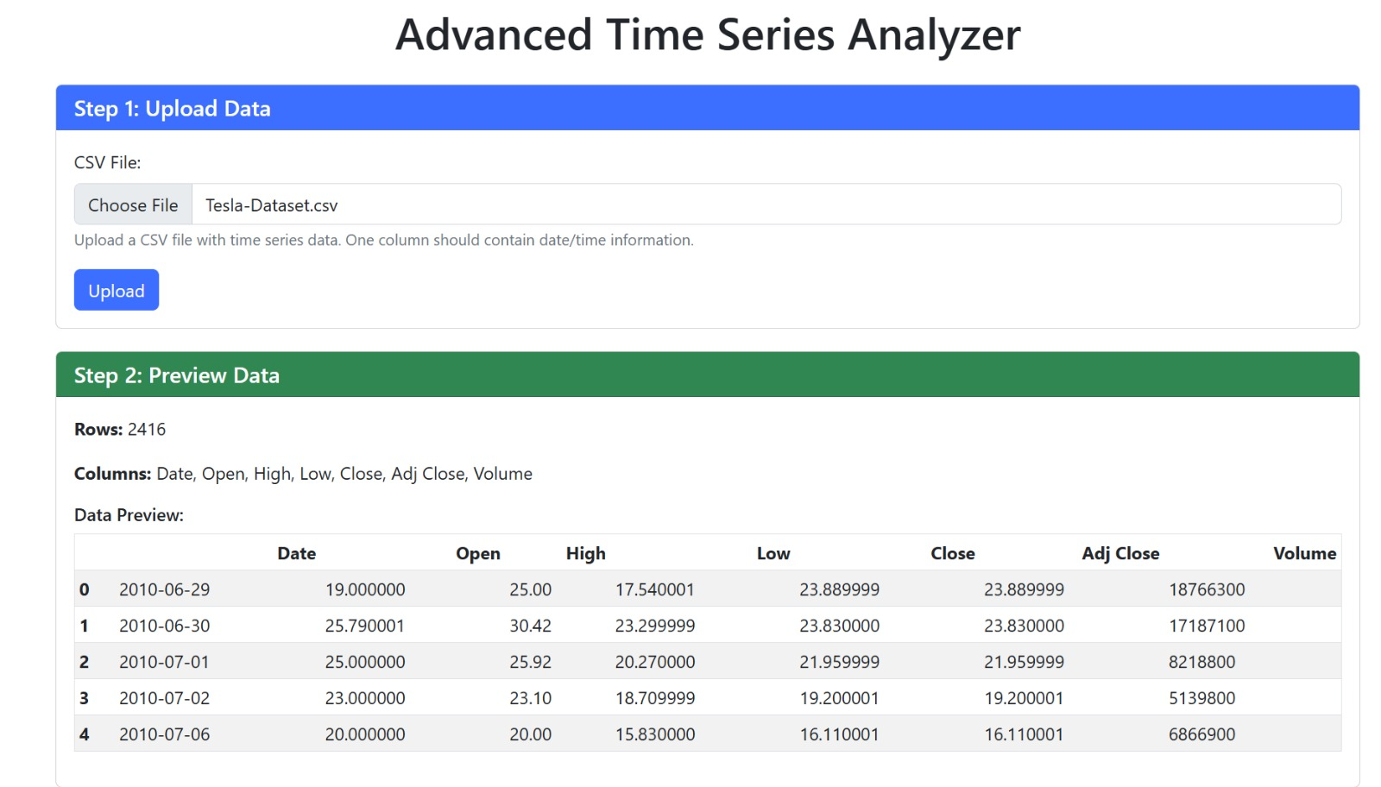
Data Visualization:

Slide 15
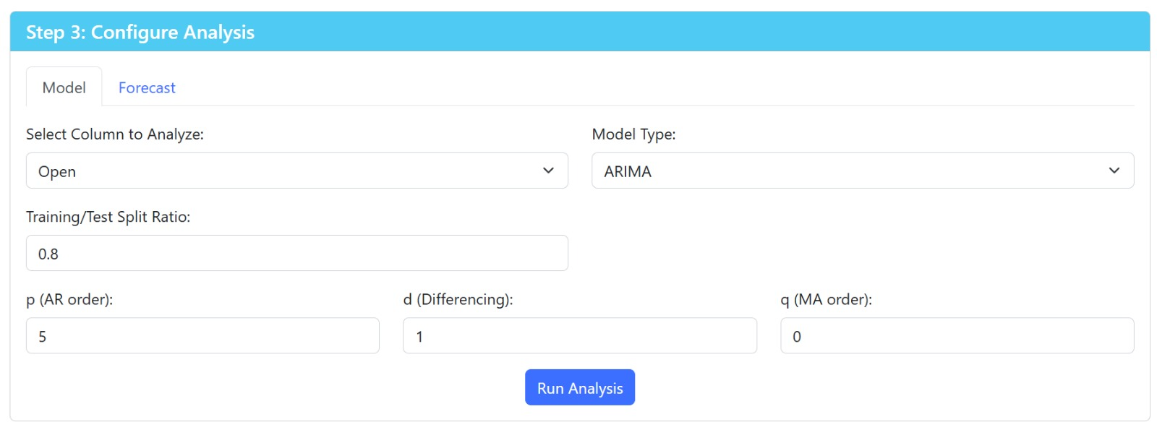
Data Visualization:

Slide 16
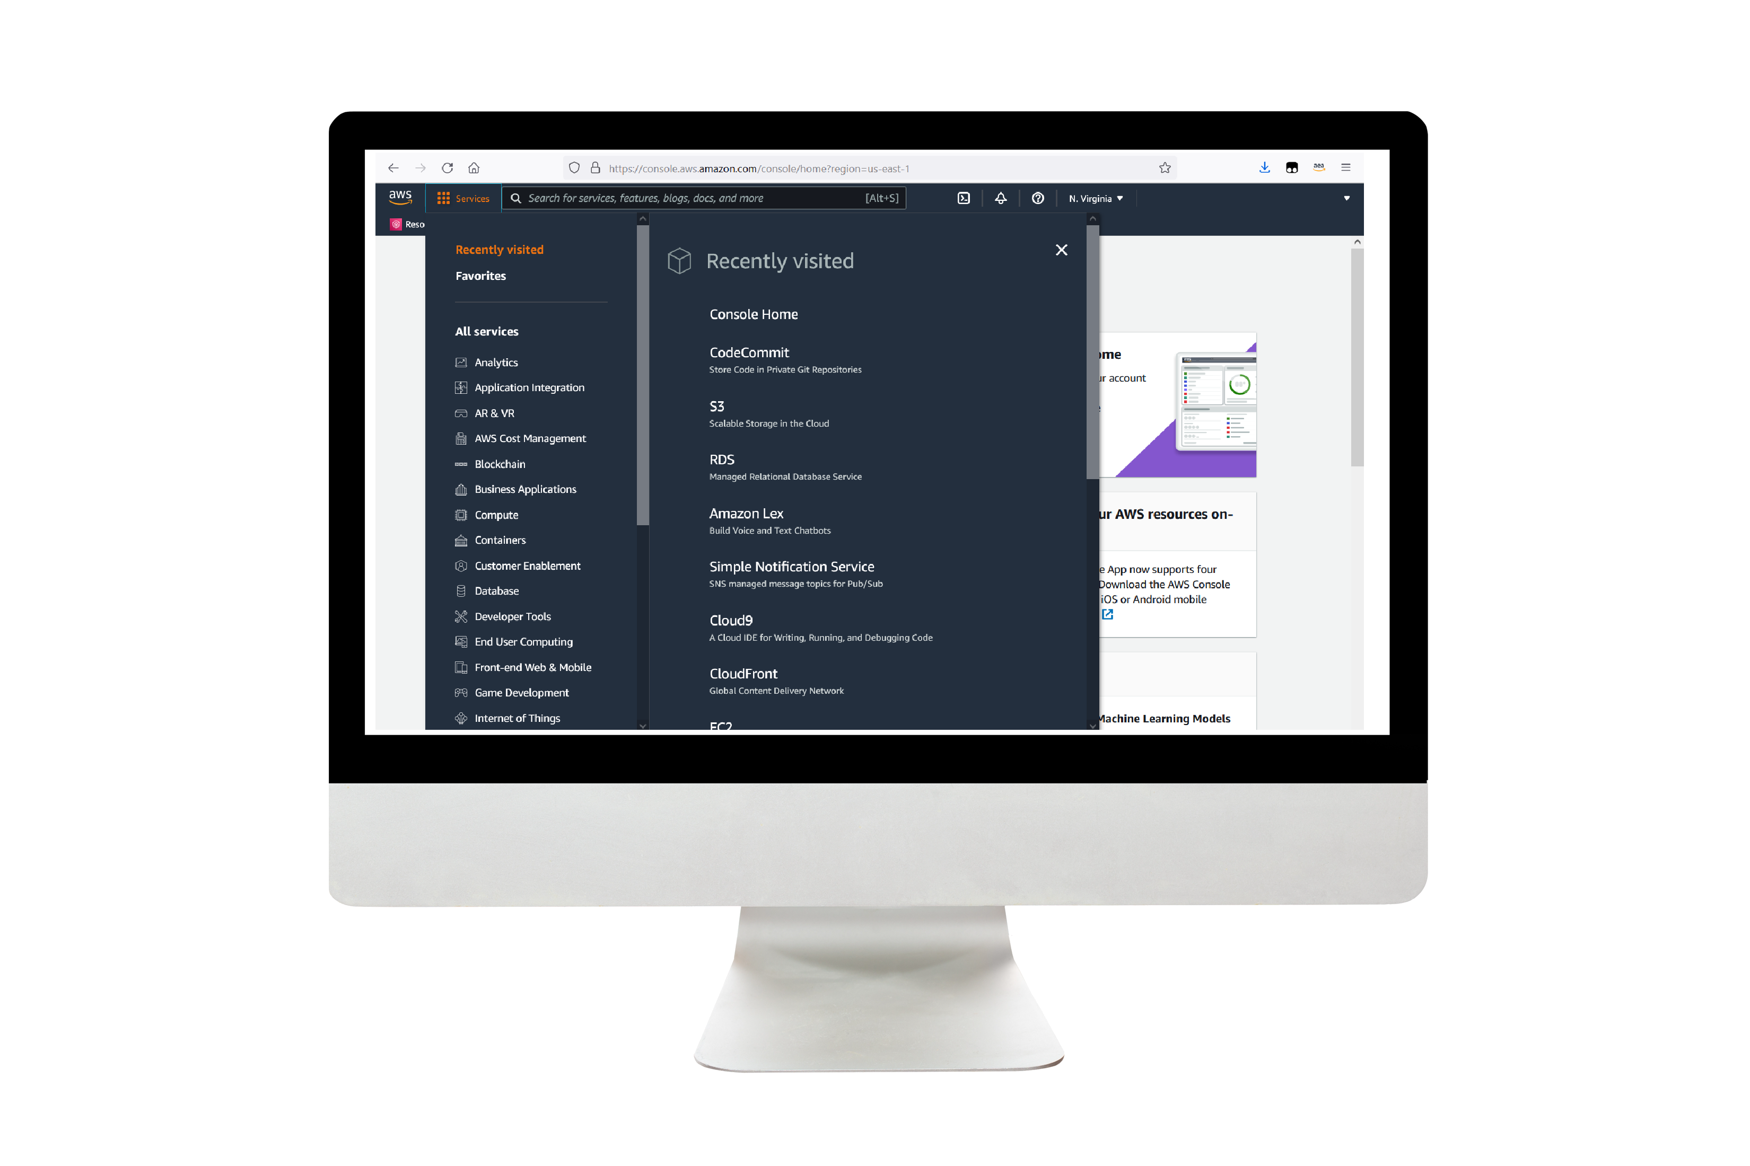
Git-Hub Link
https://github.com/penmetsagajendravarma/DSCI-6007-01-Final-Project
Notes:
For the demo, guide the audience through the two to three most important benefits of the solution and how it addresses the requirements.
Your demo materials can be screen captures, recordings, a link to your final solution, and/or a link to AWS console.

Slide 17
Thank you

